Slide 1


GSRTC Service Analysis
Presented By
Nisarg Godhani : 22BCE096
Hit Vaghela: 22BCE368
Parth Raval : 22BCE232
Bhumil Nakrani : 22BCE201
Arya Vaja : 22BCE373
Notes:
1.7.2013
‹#›

Slide 2

INTRODUCTION
The Gujarat State Road Transport Corporation (GSRTC) is a key player in Gujarat's public transportation sector.
Provides reliable and affordable travel solutions across urban and rural areas.
Operates a diverse fleet, including AC, non-AC seating, and sleeper coaches.
Ensures connectivity within Gujarat and to neighboring states.
Focuses on service quality, customer satisfaction, and operational efficiency.
Implements modern technologies like online booking, GPS tracking, and real-time updates.
Notes:
1.7.2013
‹#›

Slide 3
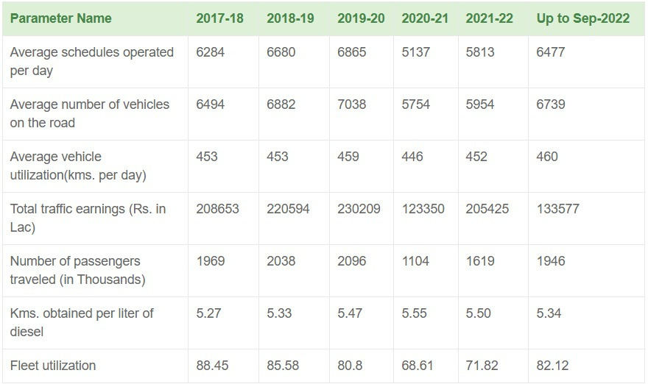
INDUSTRY OVERVIEW
The data indicates a decline in operational efficiency and earnings during 2020-21, likely due to the COVID-19 pandemic, followed by a gradual recovery in 2021-22 and 2022. Fleet utilization and the number of passengers have shown improvement post-pandemic, but key metrics like vehicle utilization and fuel efficiency remain relatively stable. Total traffic earnings are recovering but haven't yet reached pre-pandemic levels.
Notes:
1.7.2013
‹#›

Slide 4
Objectives and SPSS Analysis Overview
•Objectives of the Analysis:
Evaluate customer satisfaction using the SERVQUAL model (Tangibles, Reliability, Responsiveness, Assurance, Empathy).
•Identify gaps between passenger expectations and service quality.
•Provide recommendations for service improvement based on data insights.
•Purpose of Using SPSS for Statistical Analysis:
•SPSS was used to analyze survey responses from 217 participants, helping to quantify perceptions of GSRTC’s service quality.
•Enables detailed statistical tests to identify significant trends in customer satisfaction.
Notes:
1.7.2013
‹#›

Slide 5
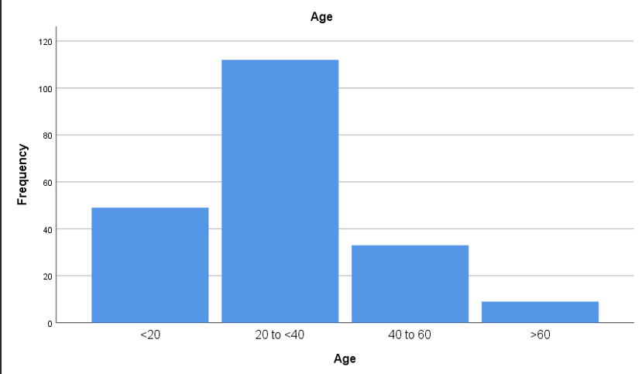
Frequency Analysis
Age
 |  | Frequency | Percent | Valid Percent | Cumulative Percent
Valid | <20 | 49 | 24.1 | 24.1 | 24.1
 | 20 to <40 | 112 | 55.2 | 55.2 | 79.3
 | 40 to 60 | 33 | 16.3 | 16.3 | 95.6
 | >60 | 9 | 4.4 | 4.4 | 100
 | Total | 203 | 100 | 100
The majority (79.3%) of GSRTC users are below 40 years, with the largest group (55.2%) aged 20 to <40. Younger users (<20) make up 24.1%, while middle-aged (16.3%) and senior citizens (4.4%) are fewer. This indicates GSRTC services are most popular among young adults.
Notes:
1.7.2013
‹#›

Slide 6
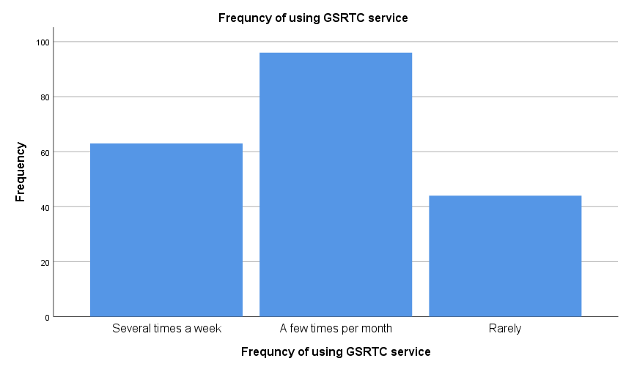
Frequency Analysis
Frequncy of using GSRTC service |  | Frequency | Percent | Valid Percent | Cumulative Percent
Valid | Several times a week | 63 | 31 | 31 | 31
 | A few times per month | 96 | 47.3 | 47.3 | 78.3
 | Rarely | 44 | 21.7 | 21.7 | 100
 | Total | 203 | 100 | 100
The survey shows that the highest number of respondents (around 100) use GSRTC services a few times per month. Approximately 65 respondents travel several times a week, while around 45 respondents use the service rarely. This indicates that most users rely on GSRTC for occasional travel rather than daily commuting.
Notes:
1.7.2013
‹#›

Slide 7
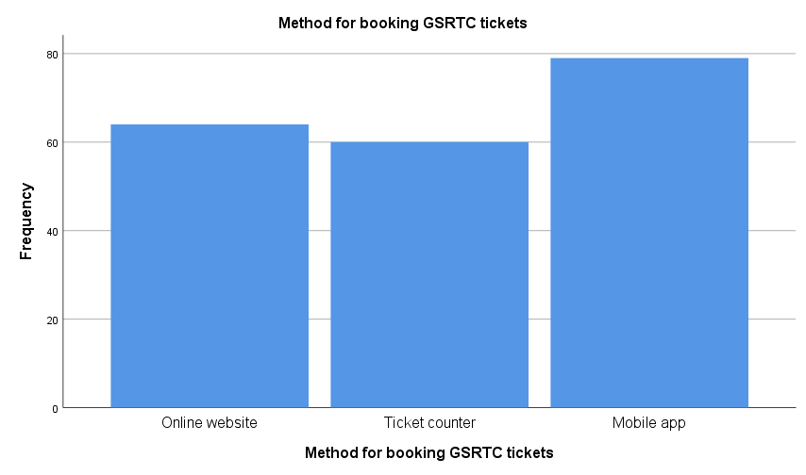
Frequency Analysis
Method for booking |  | Frequency | Percent | Valid Percent | Cumulative Percent
Valid | Online website | 64 | 31.5 | 31.5 | 31.5
 | Ticket counter | 60 | 29.6 | 29.6 | 61.1
 | Mobile app | 79 | 38.9 | 38.9 | 100
 | Total | 203 | 100 | 100
The most preferred method for booking GSRTC tickets is the mobile app (38.9%, 79 respondents), followed by the online website (31.5%, 64 respondents). The ticket counter is the least used method (29.6%, 60 respondents). This indicates a strong shift toward digital booking options over traditional counters.
Notes:
1.7.2013
‹#›

Slide 8

Chi - square test
Hypotheses:
Null Hypothesis (H₀): There is no significant association between personal annual income and the frequency of using GSRTC services.
Alternative Hypothesis (H₁): There is a significant association between personal annual income and the frequency of using GSRTC services.
Notes:
1.7.2013
‹#›

Slide 9
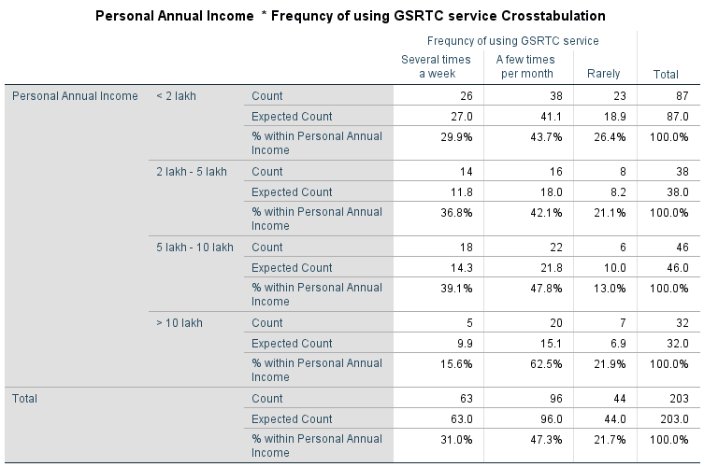
Chi - square test
Notes:
1.7.2013
‹#›

Slide 10
The Chi-Square test shows no significant relationship (p = 0.211) between personal annual income and GSRTC usage frequency.
Chi-Square Tests | Value | df | Asymptotic Significance (2-sided)
Pearson Chi-Square | 8.393a | 6 | 0.211
Likelihood Ratio | 8.921 | 6 | 0.178
Linear-by-Linear Association | 0.06 | 1 | 0.806
N of Valid Cases | 203
Across all income groups, the most common usage pattern is "a few times per month" (47.3% overall).
Higher-income individuals (>10 lakh) use GSRTC less frequently (15.6% travel several times a week), but the difference is not statistically significant.
Notes:
1.7.2013
‹#›

Slide 11
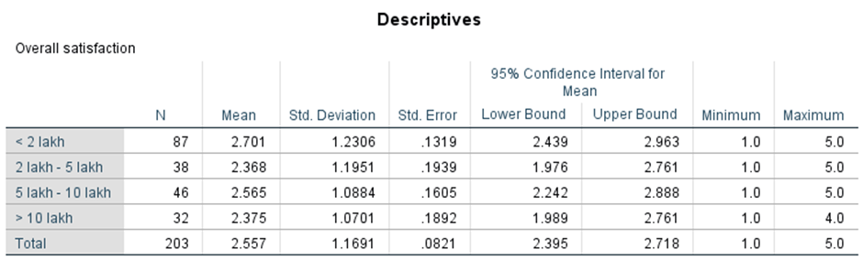
ANOVA Insights
Notes:
1.7.2013
‹#›

Slide 12
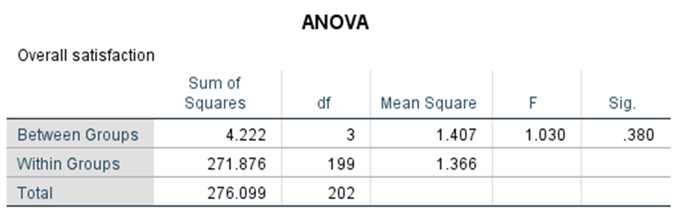
Combined Conclusion:
The ANOVA results indicate that the income groups do not differ significantly in terms of overall satisfaction.
Final Interpretation: The null hypothesis is not rejected, suggesting that any differences in satisfaction levels among the income groups are not statistically significant.
Notes:
1.7.2013
‹#›

Slide 13
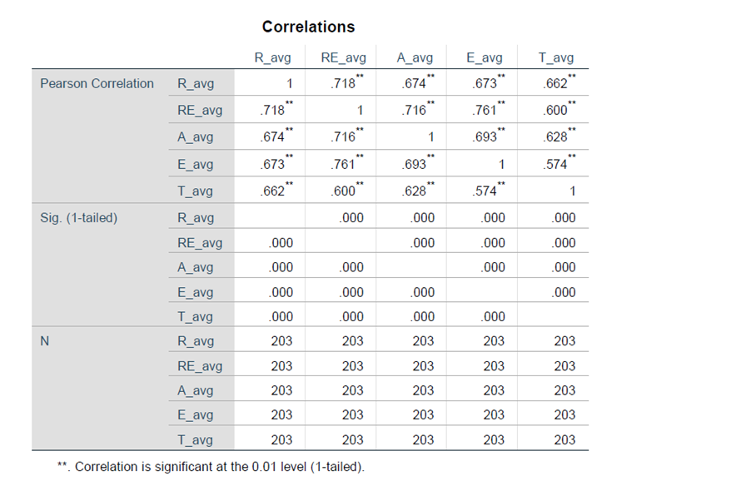
Regression
Result analysis :
The correlation analysis reveals strong, positive relationships between variables like R_avg, RE_avg, A_avg, E_avg, and T_avg, with coefficients ranging from 0.574 to 0.761. All correlations are highly significant (p = 0.000), indicating that as one variable improves, others tend to follow. This suggests interdependence, where enhancing one aspect (e.g., reliability) can positively impact others (e.g., efficiency or timeliness).
Notes:
1.7.2013
‹#›

Slide 14
Gap Analysis (Expectation vs Perception)
A significant gap exists between what customers expect and what they perceive, primarily in reliability and responsiveness.
• The study evaluated the service quality of GSRTC using the SERVQUAL model, which measures gaps between customer expectations and perceptions . The analysis focused on five dimensions- Reliability, Responsiveness, Assurance, Empathy and Tangibles.
•Expectation: Timely, well-maintained, and customer-friendly service.
•Perception: Moderate service quality with gaps in punctuality, staff behavior, and cleanliness.
Notes:
1.7.2013
‹#›

Slide 15
Summary of Research Findings
Reliability is key – Improve scheduling, real-time tracking, and maintenance.
Assurance matters – Train staff for professionalism and visible safety measures.
Cleanliness & infrastructure – Modern, well-maintained buses enhance experience.
Digital vs. comfort preferences – Younger users prefer apps; older passengers value reliability.
Income & travel class impact – Higher-income/AC travelers seek comfort; lower-income/non-AC focus on affordability.
Action Plan: Enhance reliability, safety, cleanliness, and tailored services for all passengers.
Notes:
1.7.2013
‹#›

Slide 16
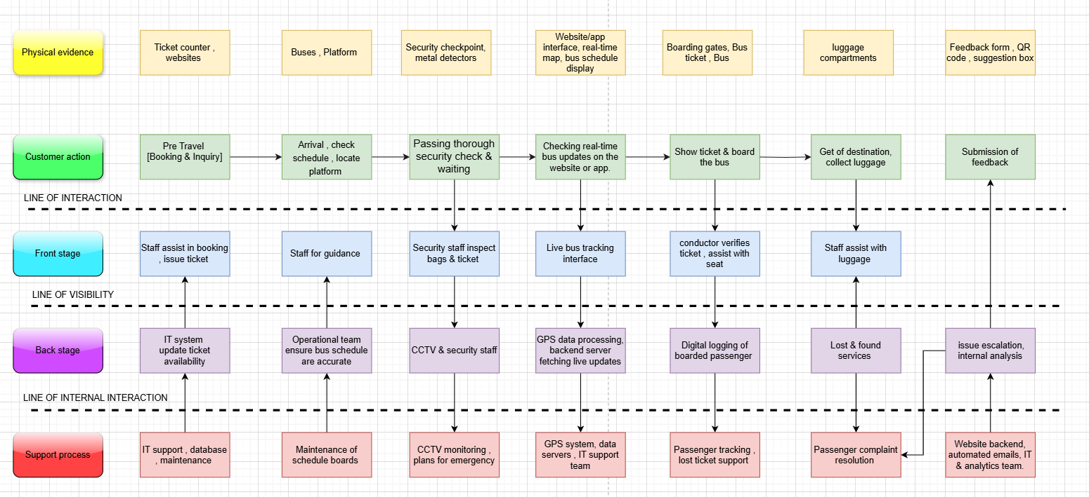
Blueprint
Notes:
1.7.2013
‹#›

Slide 17
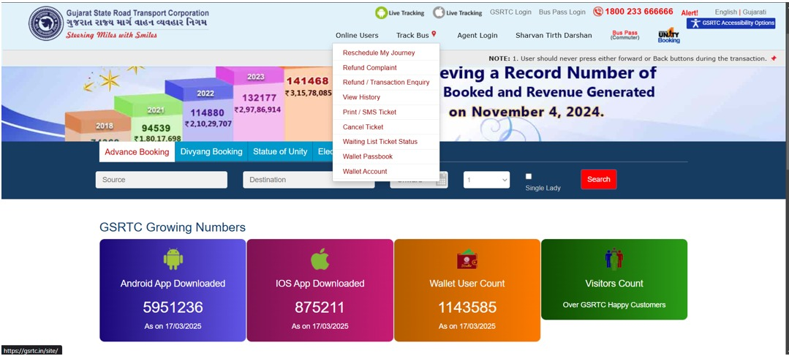
Physical Evidence
GSRTC website
Notes:
1.7.2013
‹#›

Slide 18
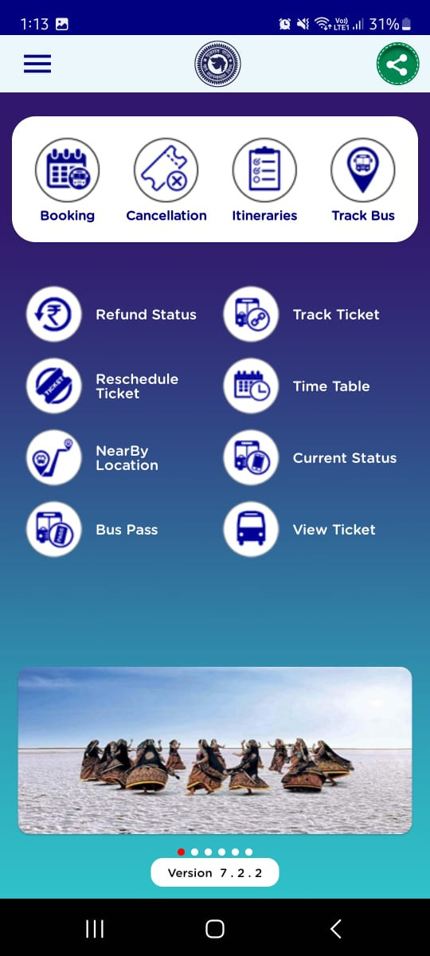
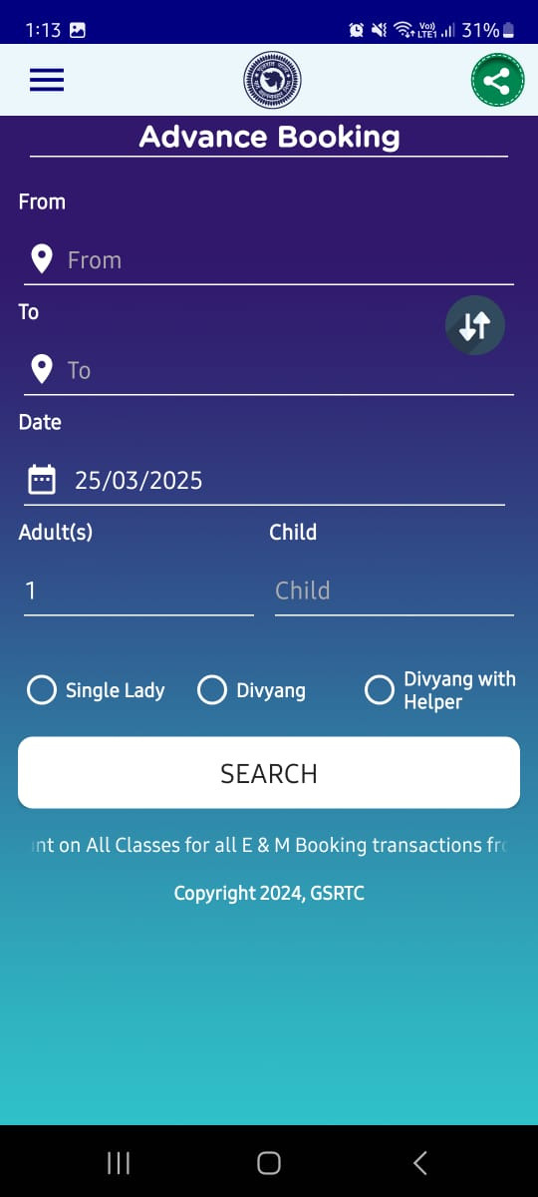
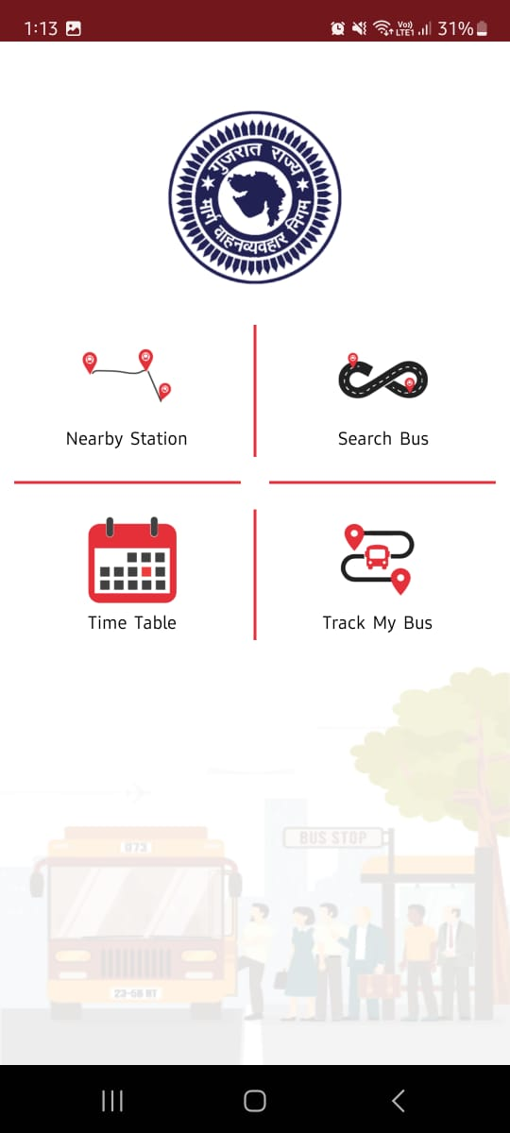
Physical Evidence
Gsrtc mobile app
Booking interface
Gsrtc live app for tracking the bus
Notes:
1.7.2013
‹#›

Slide 19
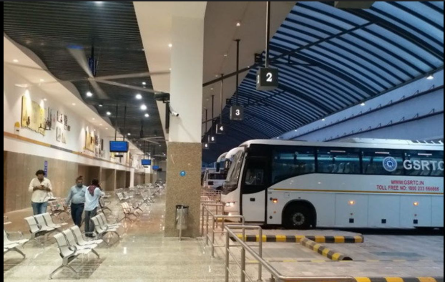
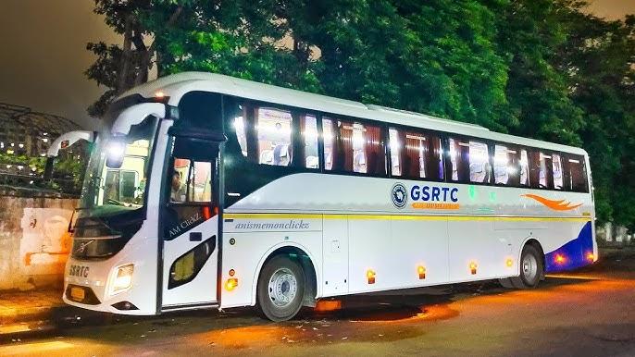
Bus Station
Bus Exterior
Notes:
1.7.2013
‹#›

Slide 20
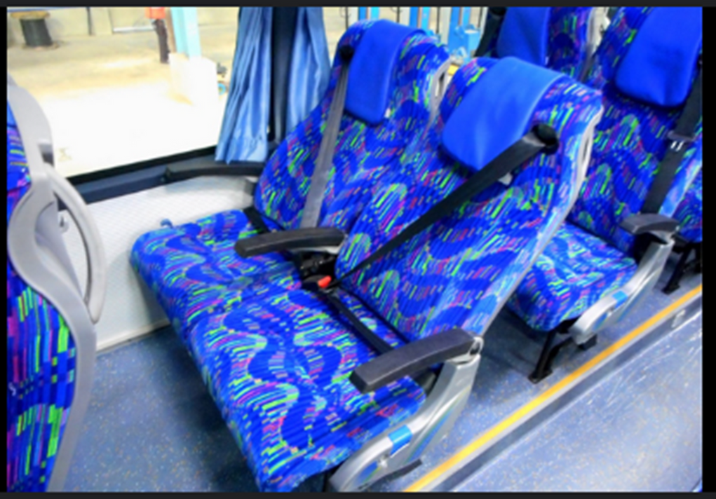
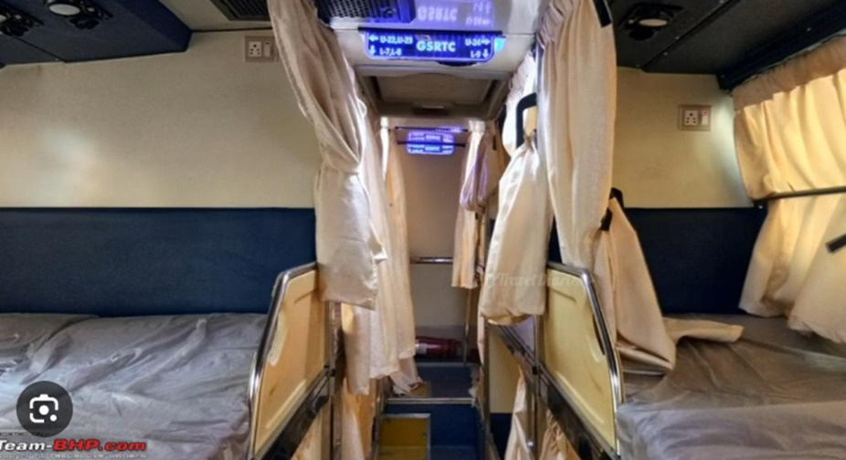
Bus Interior
Seater
Sleeper
Notes:
1.7.2013
‹#›

Slide 21
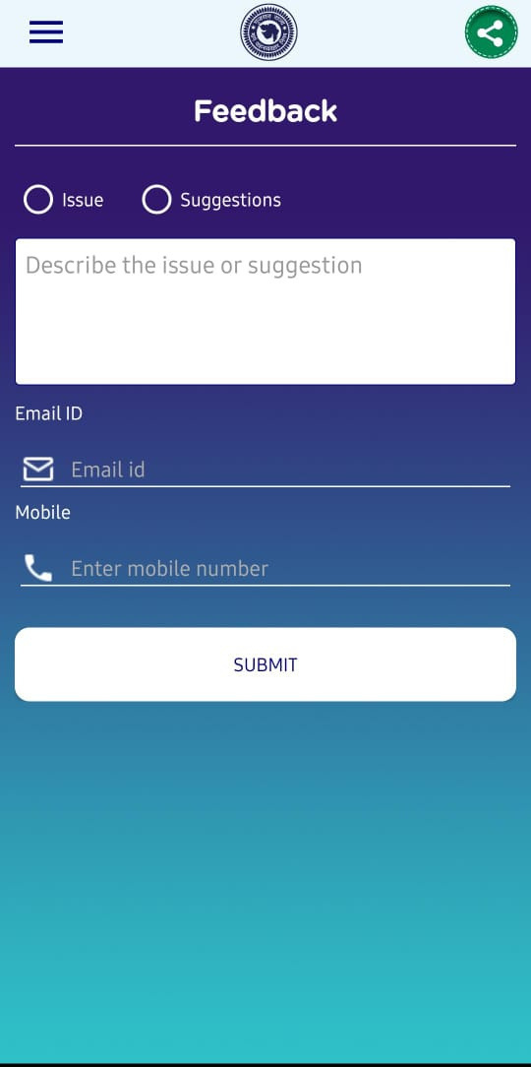
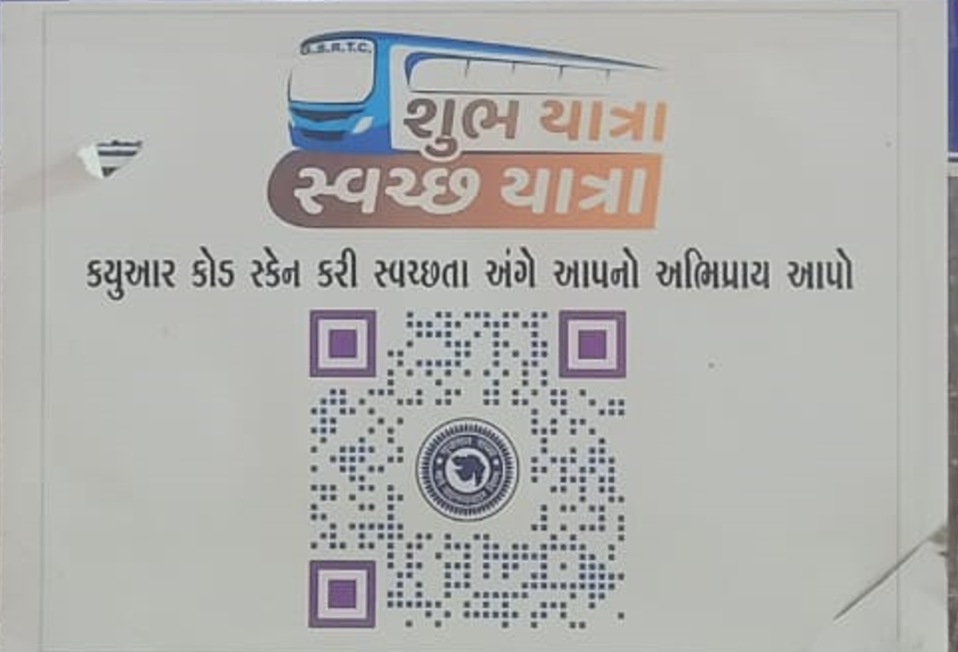
Service Feedback
QR Code Feedback System
Online feedback form
Notes:
1.7.2013
‹#›

Slide 22
Conclusion
•The GSRTC analysis using the SERVQUAL model highlights reliability as the key factor affecting passenger satisfaction, with delays and scheduling issues being major concerns. Responsiveness, assurance, tangibles, and empathy also influence service perception. Key improvements include real-time tracking, better-trained staff, enhanced safety, fleet modernization, and digital adoption. Addressing these gaps will boost satisfaction, increase ridership, and strengthen GSRTC’s competitiveness against private operators.
•The GSRTC analysis using the SERVQUAL model highlights reliability as the key factor affecting passenger satisfaction, with delays and scheduling issues being major concerns. Responsiveness, assurance, tangibles, and empathy also influence service perception. Key improvements include real-time tracking, better-trained staff, enhanced safety, fleet modernization, and digital adoption. Addressing these gaps will boost satisfaction, increase ridership, and strengthen GSRTC’s competitiveness against private operators.
Notes:
1.7.2013
‹#›

Slide 23

References
https://www.gsrtc.in/site/downloads/innerPages/performance.html
https://gsrtc.in/site/
Notes:
1.7.2013
‹#›

